Slide 1




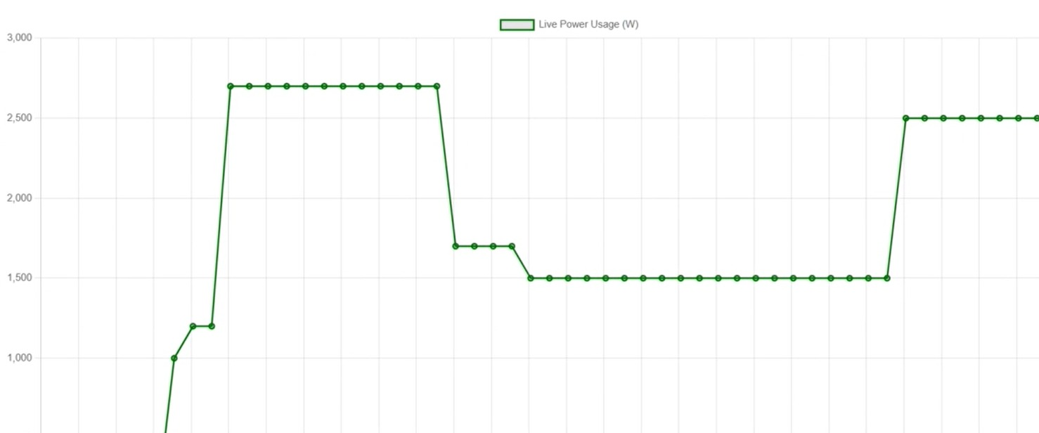
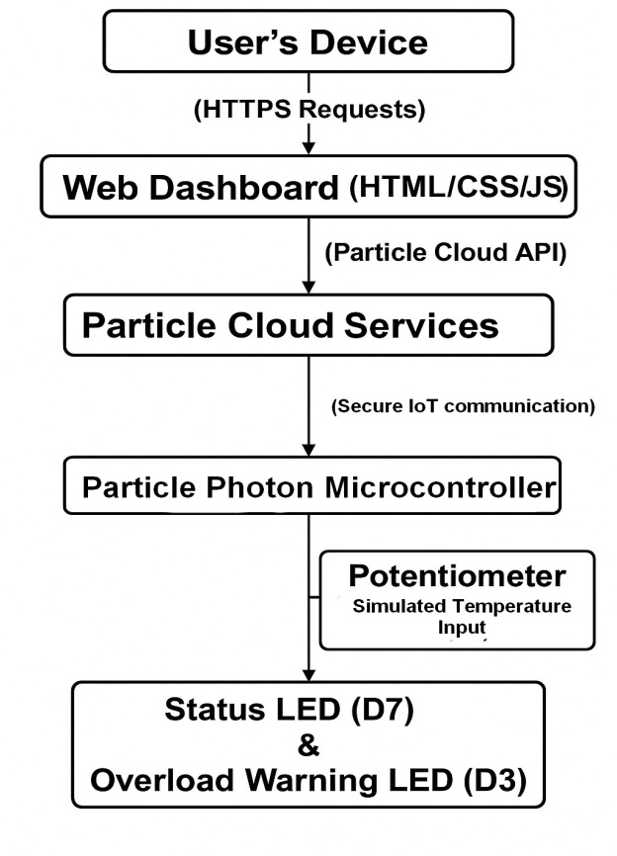
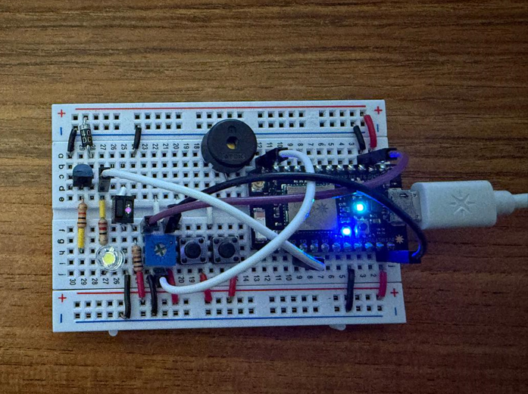
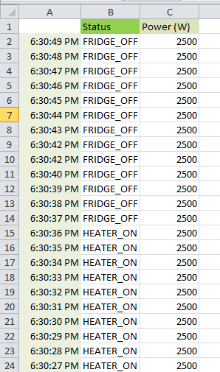
Smart Energy Monitor
Embedded Systsems CSC3328
By Kenza Toreis, Fatima Zahra Zhiri & Oumaima Ouajjou
Spring 2024/2025
Abstract
This project presents a simulated IoT-based smart energy monitoring system built with the Particle Photon microcontroller and Particle Cloud. It enables real-time appliance control, continuous power tracking, overload warnings, scheduling, and data visualization through a responsive web dashboard. By simulating high-consumption devices (heater, fridge, AC), this low-cost prototype offers an educational tool for learning embedded systems and cloud-based IoT integration—without requiring real electrical loads.
IV. Key Features
Real-time appliance control and monitoring
Simulated power consumption
Turning the potentiometer right triggers AC, left triggers the heater.
Overload detection via blinking LED
Scheduling appliance actions
Live data visualization (Chart.js)
Daily cost estimation
Smart energy-saving tips
CSV export of historical logs
II. SYSTEM DESIGN AND ARCHITECTURE
The system is built on three layers:
Hardware Layer: The Particle Photon controls simulated appliances through the potentiometer and triggers LEDs for status and overload alerts.
Cloud Layer: The Particle Cloud enables secure communication via exposed functions and variables (e.g., totalPower, control()).
User Interface: A web dashboard (HTML/CSS/JS) fetches real-time data, schedules actions, displays usage trends (via Chart.js), and provides CSV exports.
Appliance states are toggled through cloud commands. The Photon calculates total simulated power and triggers a blinking LED if it exceeds 2000W. The dashboard allows users to control appliances remotely, monitor energy levels, and receive energy-saving tips.
Fig. 3. Live Power Usage(W) Graph.
Fig. 1. System Architecture
V. Results and Analyses
Testing Environment:
The system was tested in a controlled lab using a Particle Photon microcontroller.
Simulated appliance behavior replaced physical loads.
Status and overload conditions were indicated using LEDs.
Communication with the Particle Cloud occurred over Wi-Fi; interaction with the dashboard was performed in a local browser.
Performance Metrics:
Response time between dashboard and hardware was approximately 1 second.
Power readings accurately reflected: heater (1000W), fridge (200W), AC (1500W).
Overload LED activated consistently at loads above 2000W.
Scheduled appliance toggles executed within 1 second of delay.
Real-time dashboard reflected accurate consumption and cost estimates.
Functional Observations:
Dashboard-to-device toggling was consistently responsive.
Overload LED logic was triggered under expected conditions.
Dashboard properly visualized consumption data and historical log export.
Smart energy-saving tips reflected appliance activity patterns.
Comparative Insight:
Unlike traditional meters with delayed feedback, this system offers real-time appliance-level monitoring.
The simulation-based approach offers smart functionality at lower cost, making it ideal for educational or prototyping environments.
III. Methodology
The system was developed through the following steps:
1. Hardware Setup
Connected Photon to Wi-Fi and breadboard components
Configured LEDs (D7 & D3) to signal appliance activity and overloads
A potentiometer (A0) simulating temperature
2. Firmware Development
Implemented appliance control logic using Particle Functions
Calculated simulated power: Heater (1000W), Fridge (200W), AC (1500W)
Triggered overload warnings when `totalPower > 2000W`
3. Cloud Integration
Exposed control functions and variables using Particle Cloud
Used HTTPS API for secure communication
4. Frontend Interface
Built dashboard to visualize power usage (Chart.js)
Enabled remote control and scheduling (JavaScript Fetch API)
Exported usage logs to CSV
5. Testing & Validation
Simulated appliance usage under lab conditions
Verified fast dashboard-device response (\~1s)
Confirmed correct overload triggering and scheduling accuracy
Fig. 2. Photon setup
Fig. 4. CVS power usage logs
VI. Conclusion
This project demonstrates a cost-effective, responsive, and educational IoT simulation for smart energy monitoring. It bridges embedded systems, cloud APIs, and user dashboards, offering a scalable prototype for classroom or research use.
References
[1] I. F. Akyildiz, W. Su, Y. Sankarasubramaniam, and E. Cayirci, “Wireless sensor networks: a survey,” Computer Networks, vol. 38, no. 4, pp. 393–422, Mar. 2002.
[2] M. Patel and J. Wang, “Applications, challenges, and prospective in emerging body area networking technologies,” IEEE Wireless Communications, vol. 17, no. 1, pp. 80–88, Feb. 2010.
[3] Particle.io, "Photon Development Board," [Online]. Available: https://docs.particle.io, Accessed: April, 2025.
[4] Chart.js, "Chart.js Documentation," [Online]. Available: https://www.chartjs.org Accessed: April, 2025.
Acknowledgment: We thank Dr. Fiaz Ahmed for his guidance and support throughout this project.

